Slide 1
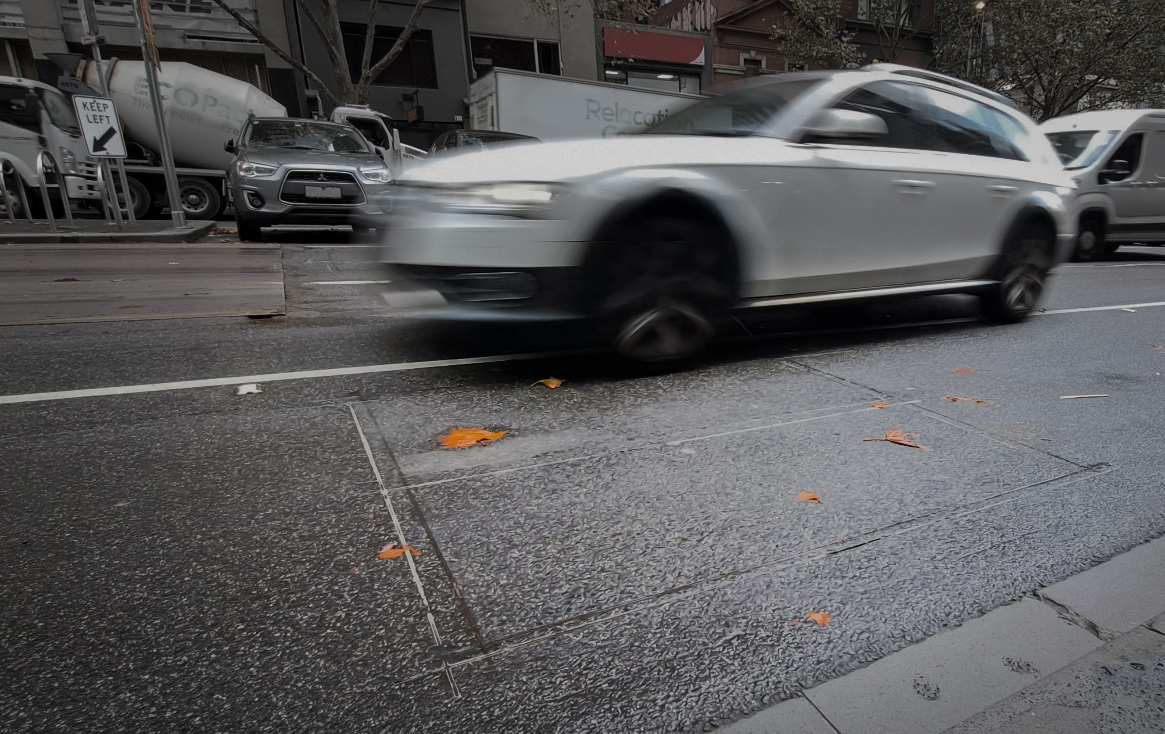

Because Every Sensor Is Unique, so Is Every Pair: Handling Dynamicity in Traffic Forecasting.
Arian Prabowo,
Wei Shao,
Hao Xue,
Piotr Koniusz, and Flora D. Salim.

Slide 2
Sensor: Inductive Loop Traffic Detector

Slide 3
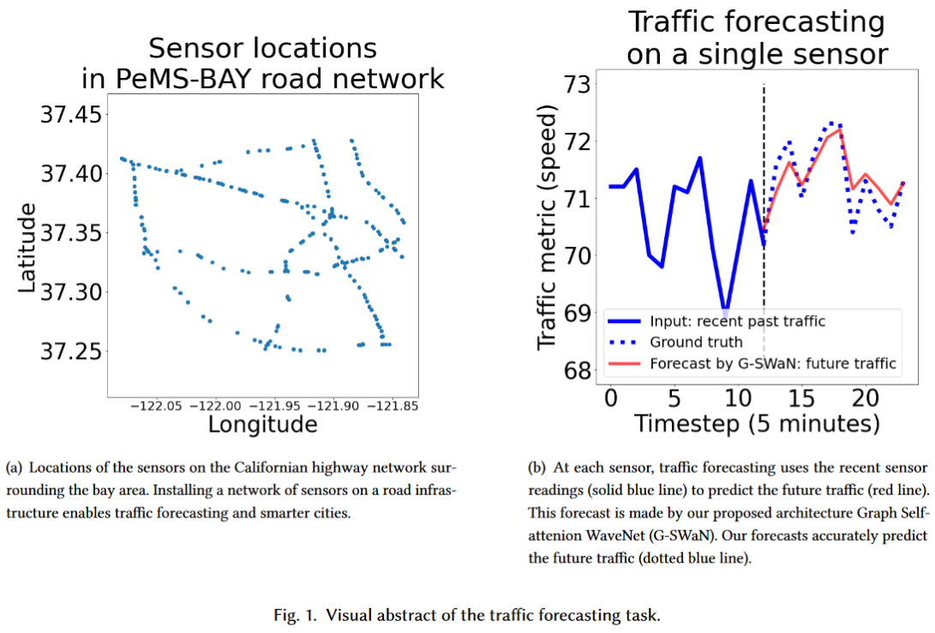
Sensor: Inductive Loop Traffic Detector

Slide 5
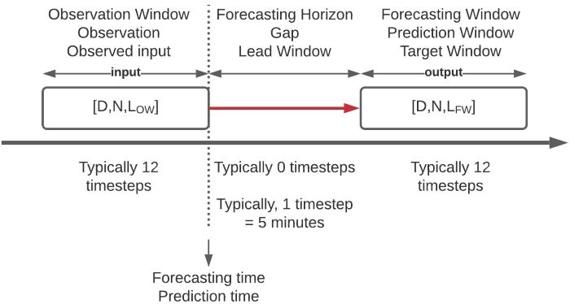
Traffic Forecasting: Problem Definition

Slide 6
Because Every Sensor Is Unique, so Is Every Pair: Handling Dynamicity in Traffic Forecasting

Slide 7
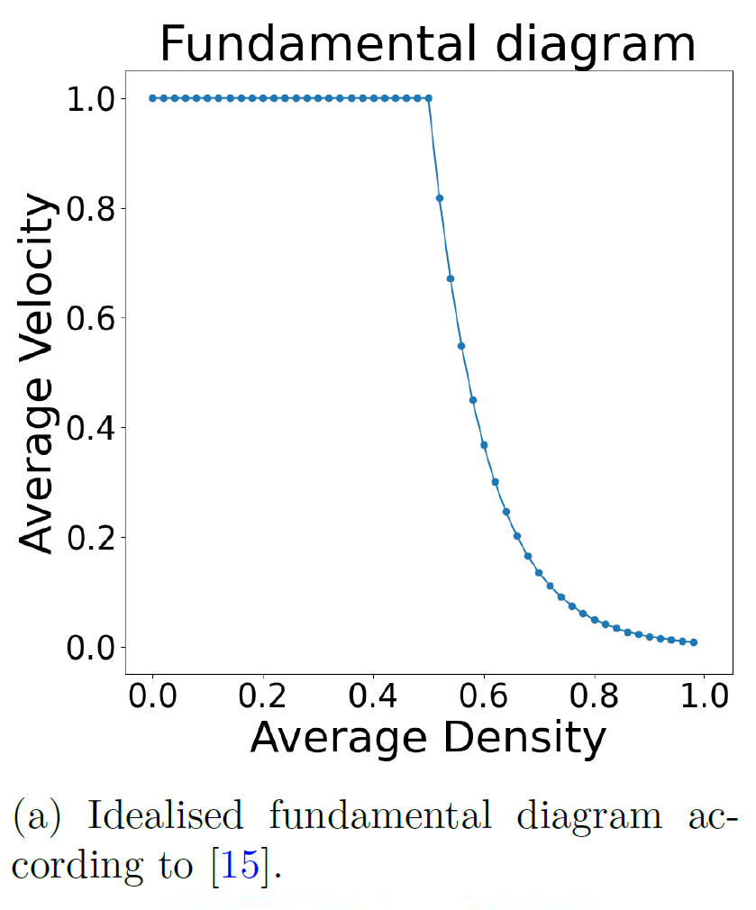
Every Sensor Is Unique

Slide 8
Every Sensor Is Unique
critical point
bound flow
free flow
congestion

Slide 9
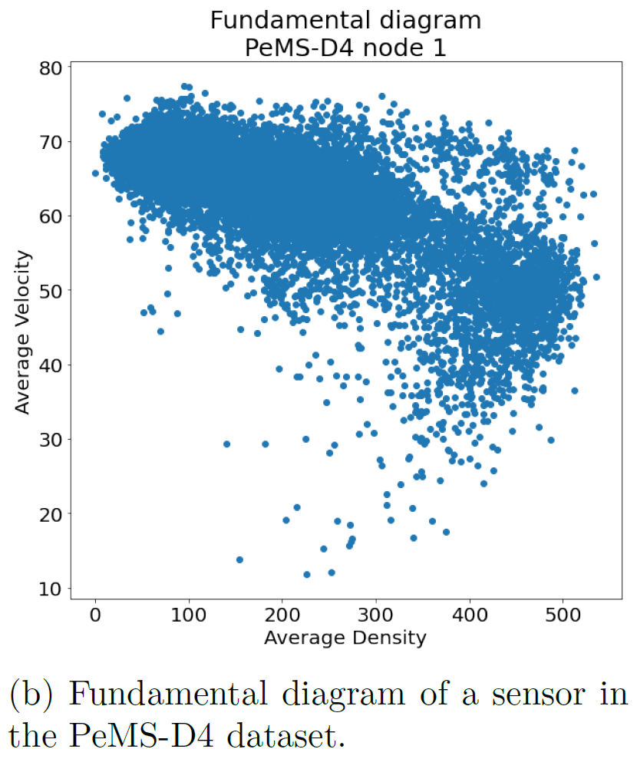
Every Sensor Is Unique

Slide 10
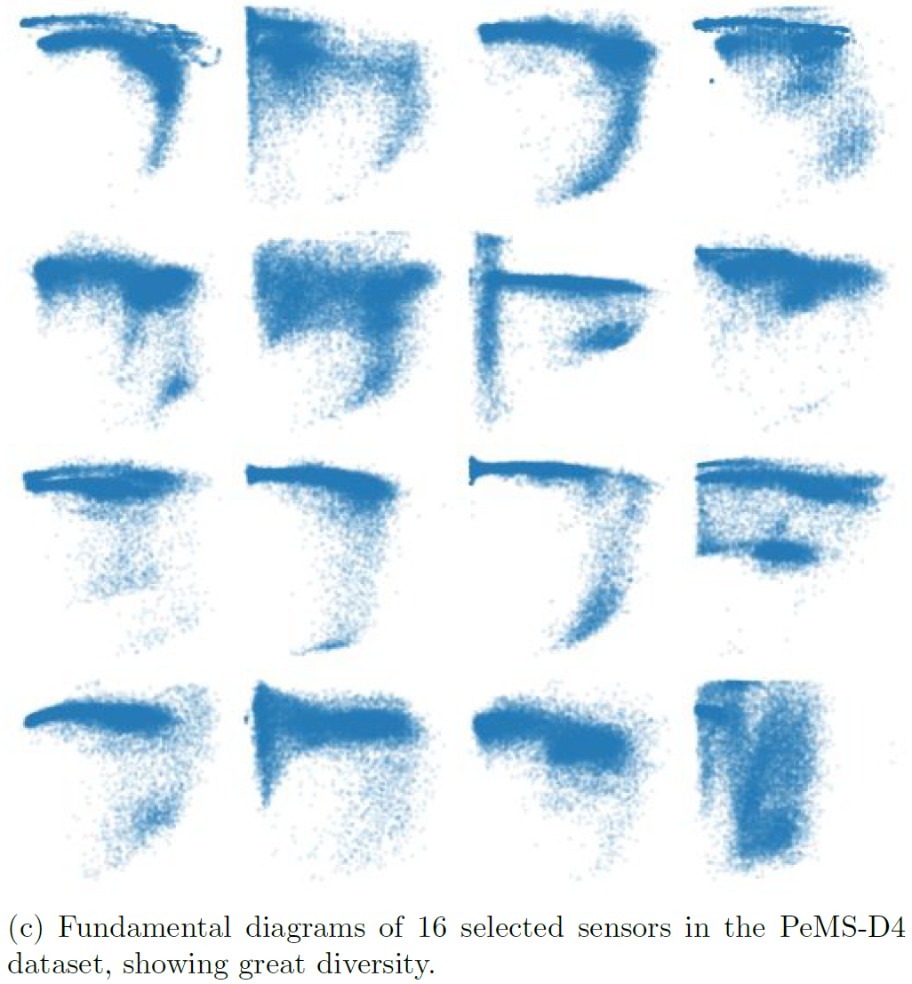
Every Sensor Is Unique

Slide 11
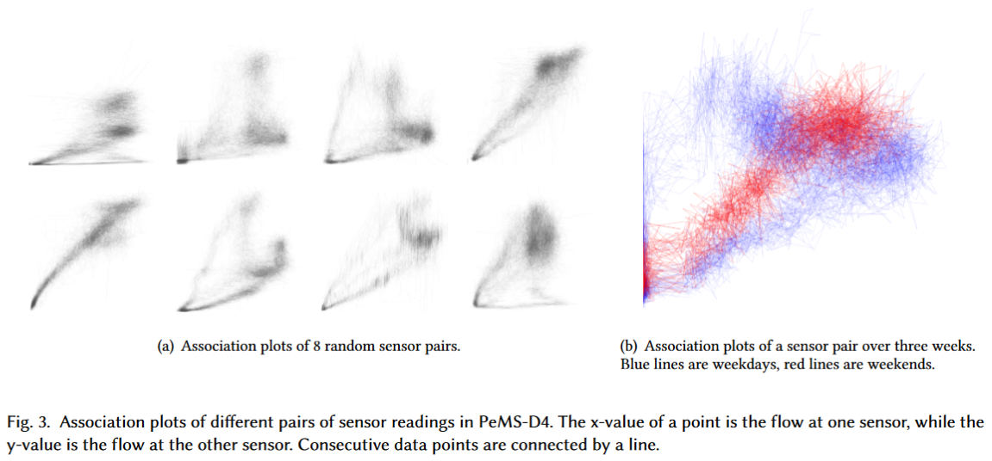
so Is Every Pair

Slide 12
so Is Every Pair

Slide 13
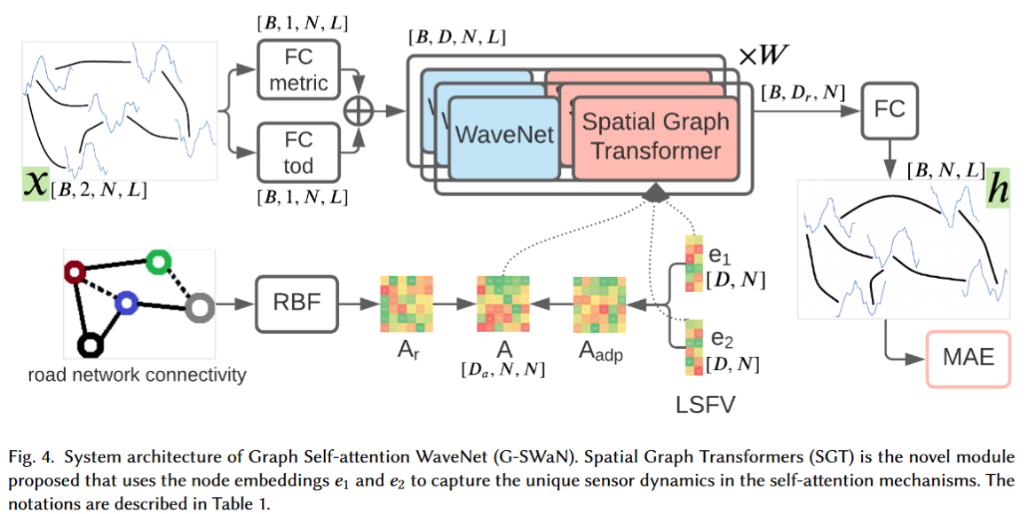
G-SWaN architecture
Notes:
How to capture the unique the unique

Slide 14
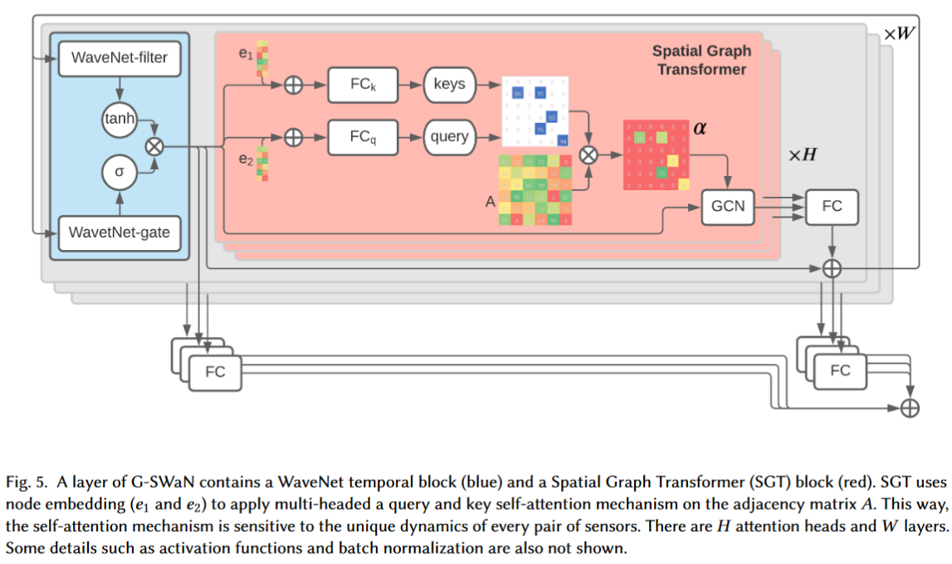
G-SWaN layer and the SGT module

Slide 15
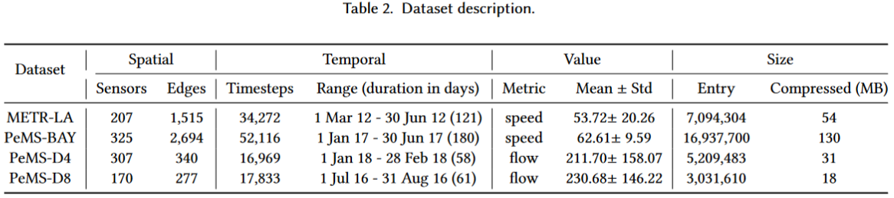
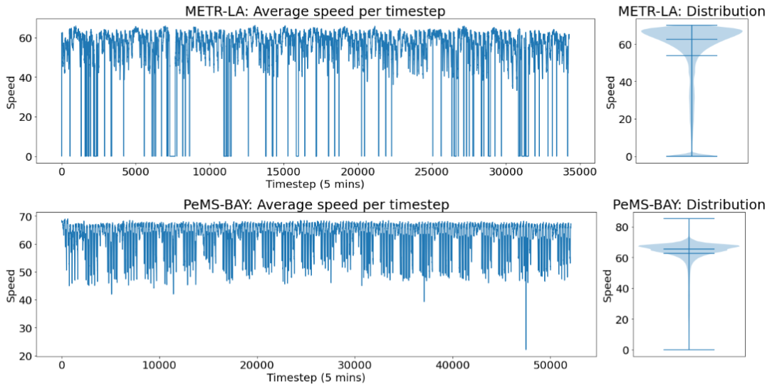
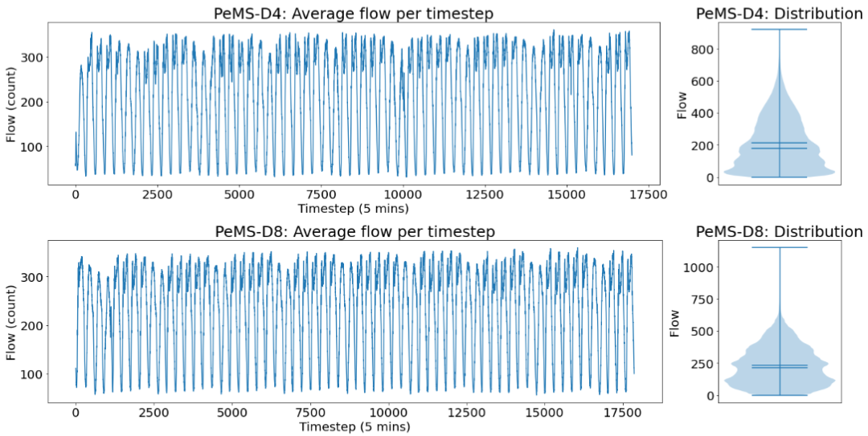

Slide 16
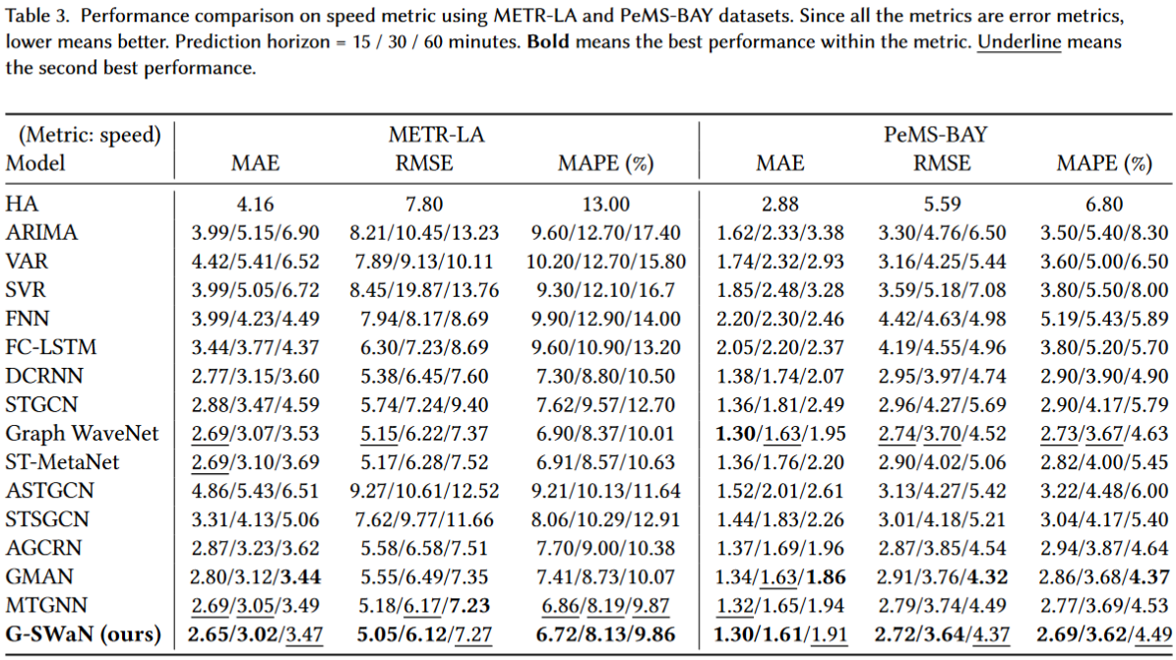
Results

Slide 17
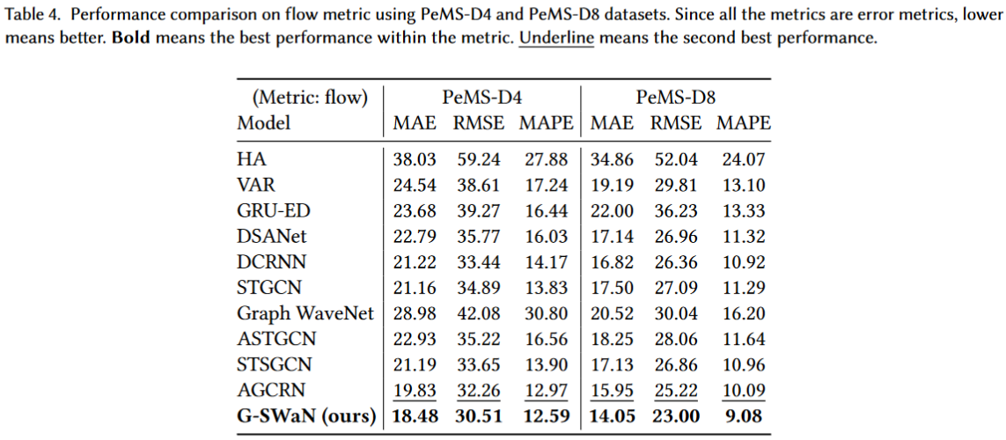
Results

Slide 18
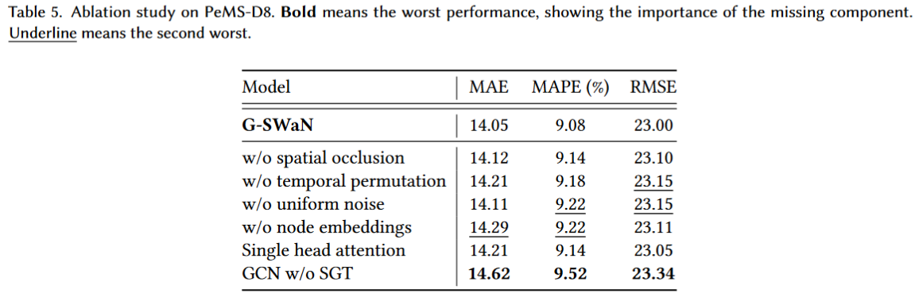
Ablation

Slide 19
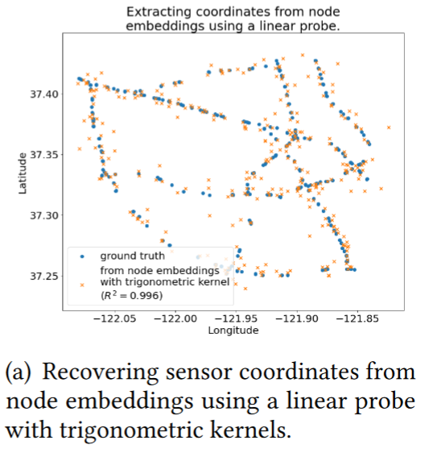
Node embeddings encode the coordinate from the traffic dynamics alone.

Slide 20
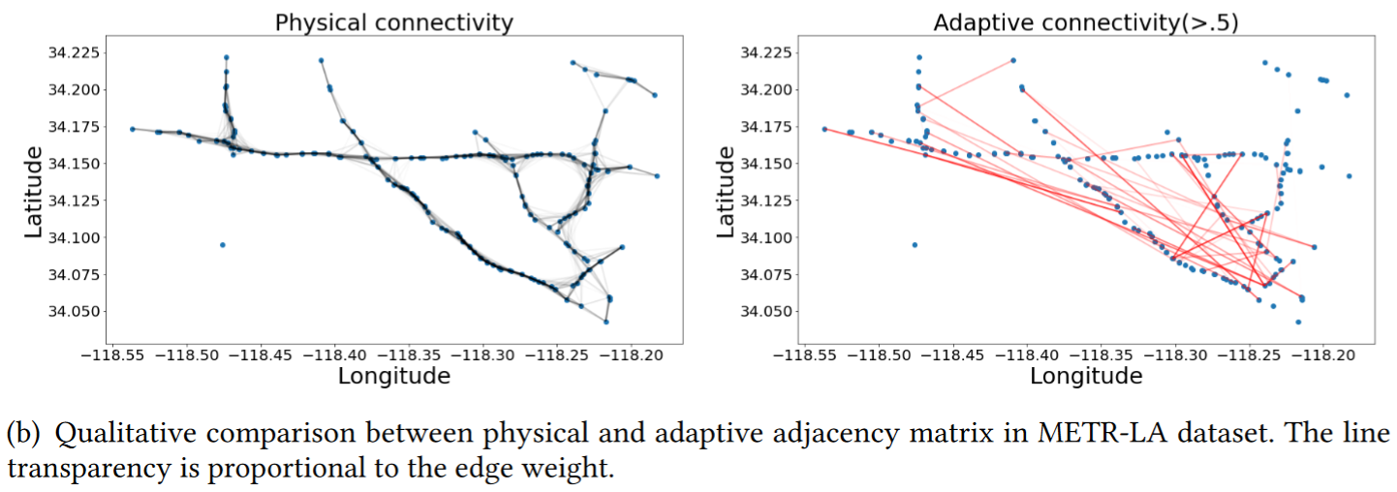
Adaptive connectivity connect distant nodes.

Slide 21

G-SWaN Because Every Sensor Is Unique, so Is Every Pair: Handling Dynamicity in Traffic Forecasting
Thank You. Any Questions?
Arian Prabowo,
Wei Shao,
Hao Xue,
Piotr Koniusz, and Flora D. Salim
Link to GitHub

